Slide 1
Erosion and Sediment Control and the Built Environment ENVE 699
Edmond C. Packee, PhD
Senior Scientist
Travis/Peterson Environmental Consulting, Inc.
Certified Professional Soil Scientist
Certified Professional in Erosion and Sediment Control
Certified Professional in Storm Water Quality
Certified Erosion, Sediment, and Storm Water Inspector

Slide 2
Erosion and Sediment Control: Permits!
Erosion and Sediment Control laws and regulations affect all aspects of the built environment!
Construction (APDES General permit for Construction Activities)
Post-Construction (APDES Multi-Sector General Permit for Industrial Activities)
Each of these General Permits impose constraints that affect:
Design;
Construction; and
Facility operations.

Slide 3
Erosion and Sediment Control: BMP Selection
There is NO available BMP that is a substitute for good design!
Comply with all permits and environmental commitments!
Minimize the disturbance footprint to extent possible;
Fit development into landscape
Account for run-on from upgradient facilities and landscapes;
Allow (require!) project to be phased during construction
Account for and minimize runoff from site post construction

Slide 4
Erosion and Sediment Control: Sediment Production diagram from AK-CESCL Recertification Program (Creative Courses/Alaska Strom Water Steering Committee)

Slide 5
Erosion and Sediment Control: BMP Focus diagram from AK-CESCL Recertification Program (Creative Courses/Alaska Strom Water Steering Committee)

Slide 6
Erosion & Sediment Control Construction Phase Permitting
Construction Phase Erosion and Sediment Controls are required!
National Pollutant Discharge Elimination System (NPDES)
Administered by US Environmental Protection Agency
NPDES Permit Coverage in Alaska is limited to:
Denali National Park & Preserve; and
Native Village of Metlakatla.
Alaska Pollutant Discharge Elimination System Permit
Administered by the Alaska Department of Environmental Conservation
APDES Coverage in Alaska is for all areas not covered by the NPDES Permit provided acreage and drainage thresholds area met.

Slide 7
Erosion & Sediment Control Construction Phase Permitting (cont.)
APDES Coverage Required for your project if:
Construction (clearing, grading, excavating) will result in soil disturbance equal to or greater than 1 ace, or
Construction (clearing, grading, excavating) will result in soils disturbance less than 1 acre but is part of a common plan of development that will ultimately disturb more than 1 acre;
AND!
Discharges storm water to surface Waters of the United States.
Local Permitting may be necessary for areas under 1 Acre if located within the boundaries of a Municipal Separate Storm Sewer System (MS4).
Municipality of Anchorage, City of Fairbanks, City of North Pole, JBER, Port of Anchorage

Slide 8
Erosion Control Construction Phase Required Controls
Erosion (Source) Controls
Delineate the project site (CGP § 4.2.1)
Minimize Extent and Duration of Exposed Soils (CGP § 4.2.2)
Maintain Buffer Areas (CGP § 4.2.3)
Control Storm Water Discharges and Flow Rates (CGP § 4.2.5)
Divert storm water around the site
Slow down or contain storm water
Place velocity dissipation devices (e.g., check dams, sediment traps, or riprap) along
the length of any conveyance channel to provide a non-erosive flow velocity.
Protect Steep Slopes (CGP § 4.2.6)
Design and construct cut-and-fill slopes in a manner that will minimize erosion!
Divert concentrated flows of storm water away from and around the disturbed portion of the slope.

Slide 9
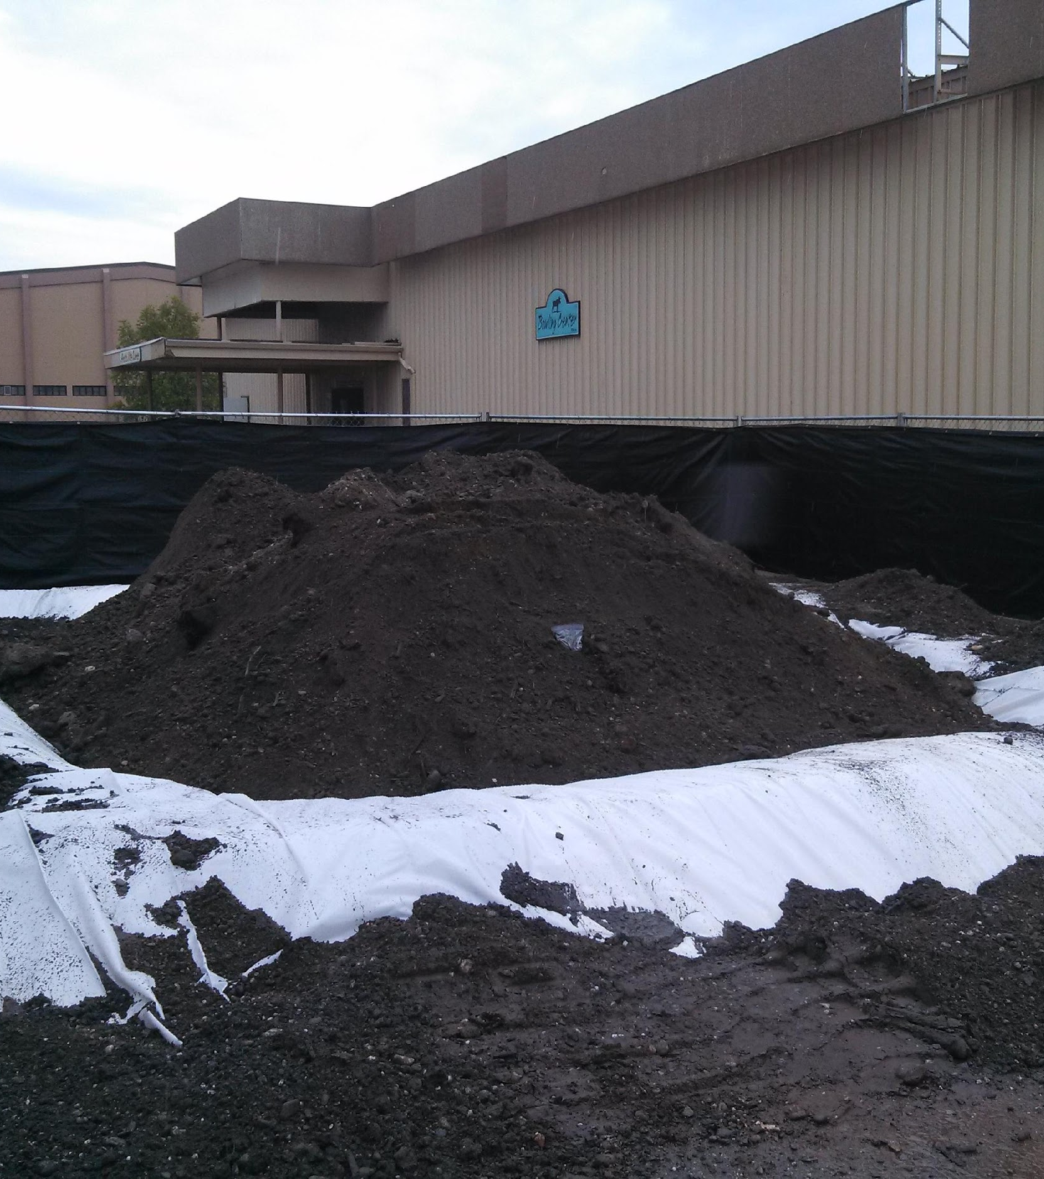
CGP § 4.2 Erosion Control
Delineate the Site

Slide 10
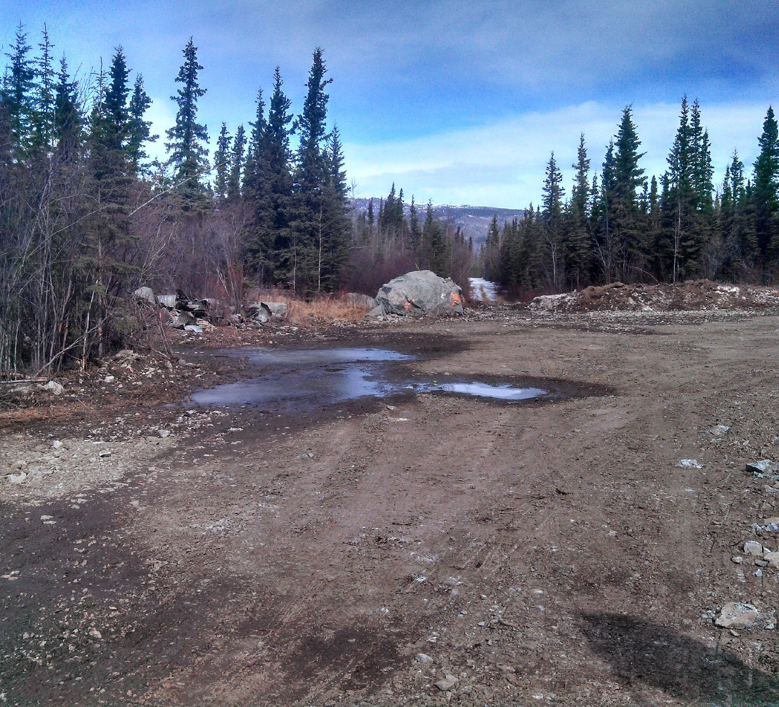
CGP § 4.2 Erosion Control
Minimize Extent and Duration of Exposed Soils

Slide 11
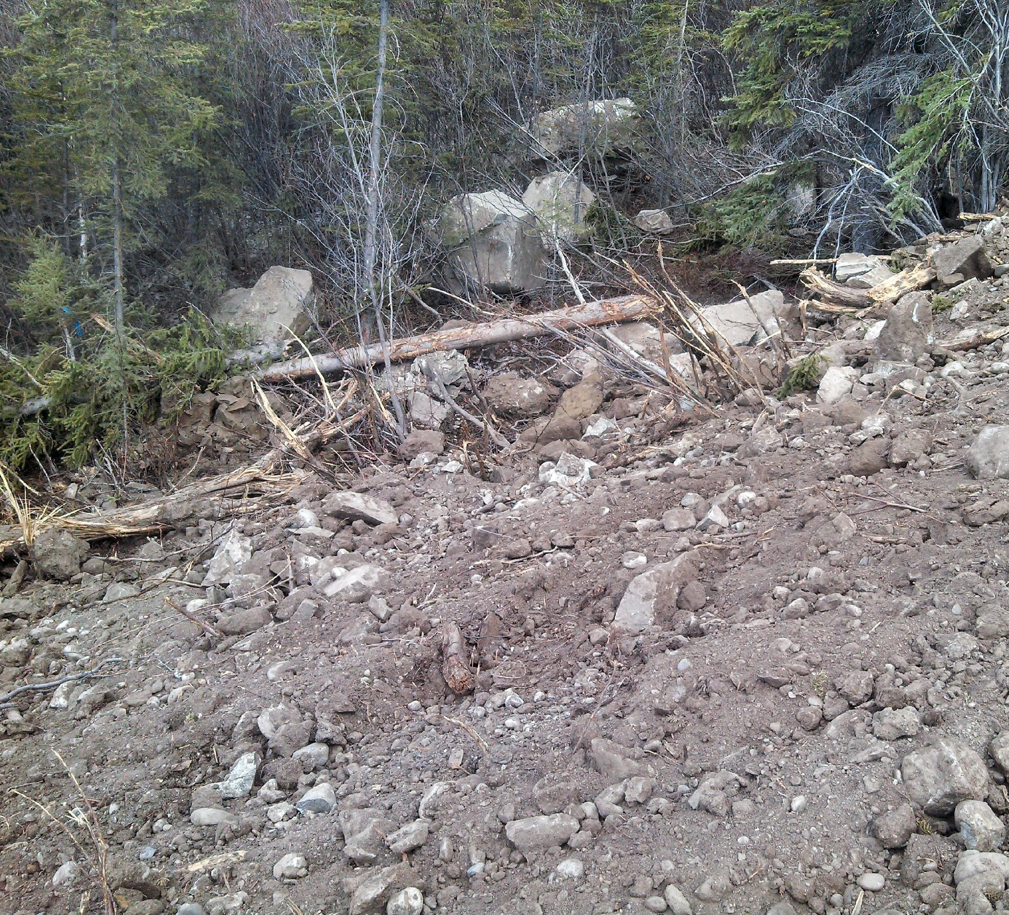
CGP § 4.2 Erosion Control
Maintain Buffer Areas

Slide 12
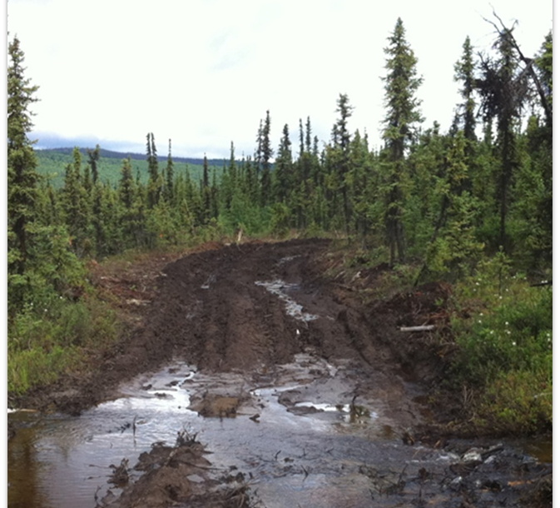
CGP 4.2 Erosion Control
Control Storm Water Discharges and Velocity

Slide 13
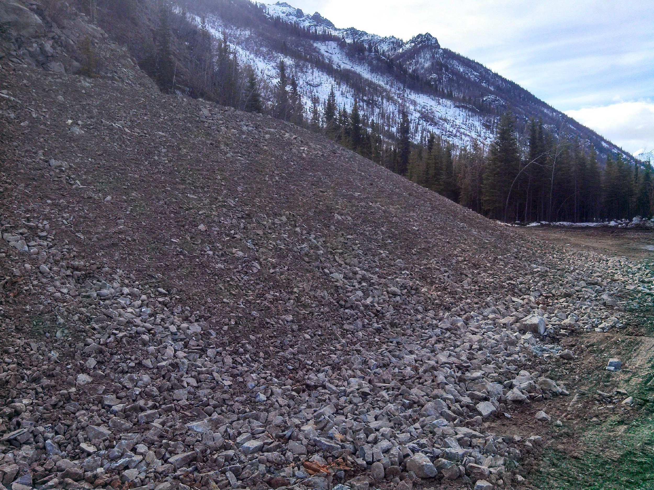
CGP § 4.2 Erosion Control
Protect Steep Slopes

Slide 14
Sediment Control Construction Phase Required Controls
Sediment Controls
Storm Water Inlet Protection (CGP § 4.3.1)
Water body Protection Measures (CGP § 4.3.2)
Downslope Sediment Controls (CGP § 4.3.3)
Construction Entrances and Exits (CGP § 4.3.4)
A permittee must establish construction vehicle access and exit points. Access and exit points should be limited to one route, if possible. If sediment escapes the construction site, off-site accumulations of sediment must be removed at a frequency sufficient to minimize off-site impacts.
Dust Generation and Track-Out from Vehicles(CGP § 4.2.5)
Soil Stockpiles (CGP § 4.2.6)
In accordance with Part 4.5.1, a permittee must stabilize or cover soil stockpiles, protect with sediment measures. Locate soil stockpiles away from storm water inlets, water bodies, and conveyance channels.

Slide 15
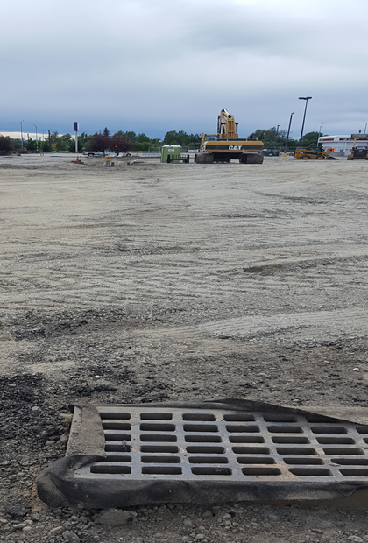
GCP § 4.3 Sediment Control
Storm Drain Inlet Protection

Slide 16
CGP § 4.3 Sediment Control
Waterbody Protection Measures

Slide 17
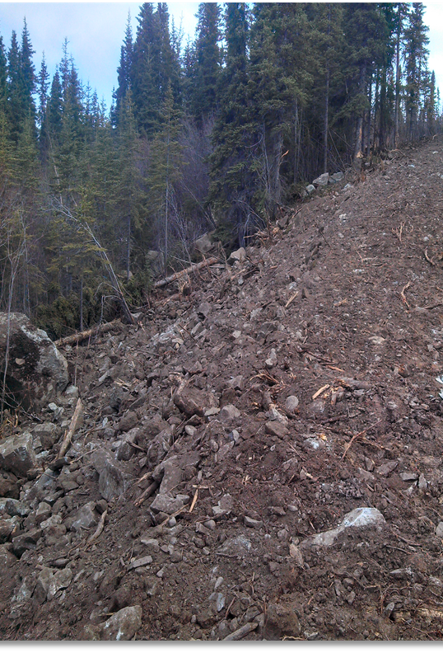
CGP 4.3 Sediment Control
Downslope Sediment Barriers

Slide 18
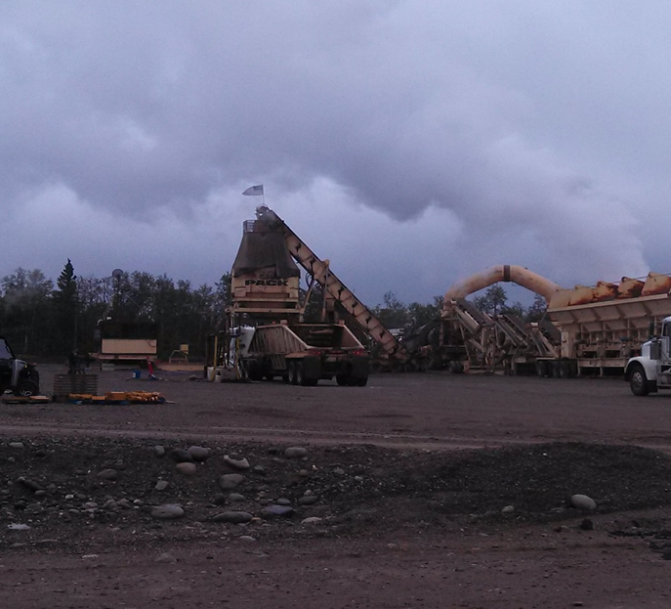
CGP § 4.3 Sediment Control
Entrances and Exits

Slide 19
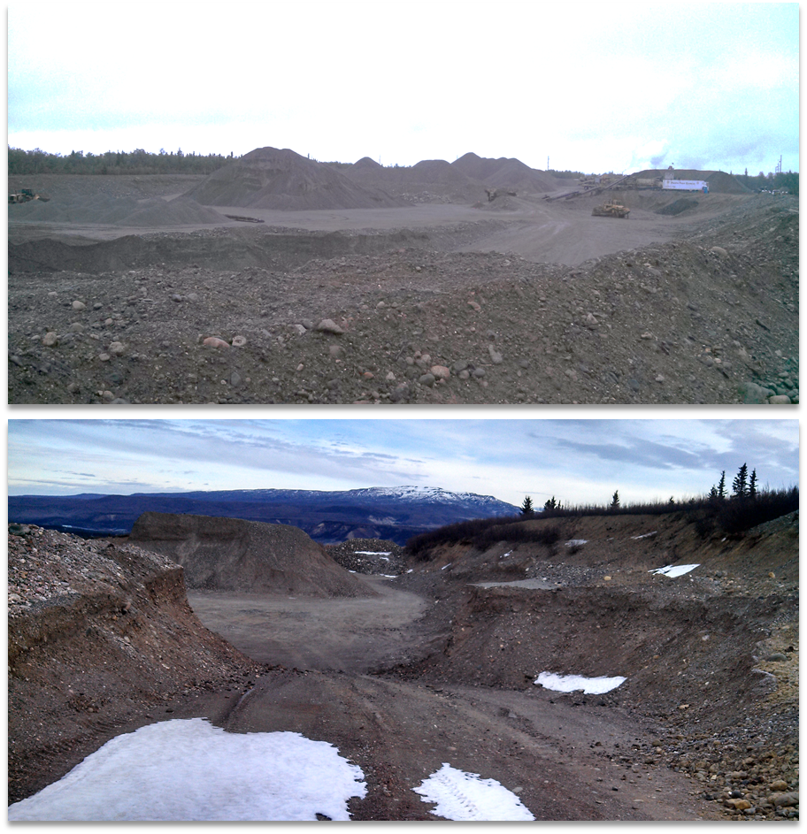
CGP 4.3 Sediment Controls
Stockpile Protection

Slide 20
Erosion and Sediment Control Lessons Learned: Construction
Temporary Best Management Practices are a supplement , but not a replacement for good design!
Once disturbed the site enters the sediment production business!
Run-on from up-gradient areas must be diverted around disturbed areas.
Runoff from disturbed areas must pass through a sediment control device prior to discharge.
Erosion control is always cheaper and more effective than sediment control
Sediment control is always more difficult and more expensive without erosion control.
80% of violations consist of improperly filled out or absent paperwork!

Slide 21
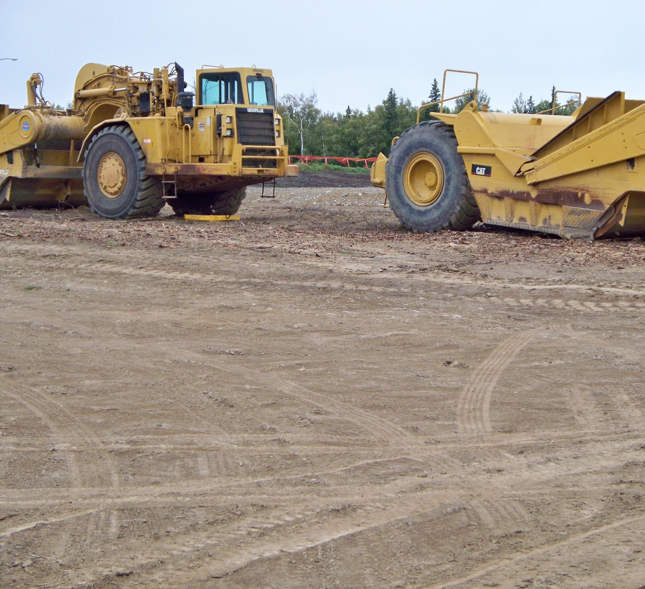
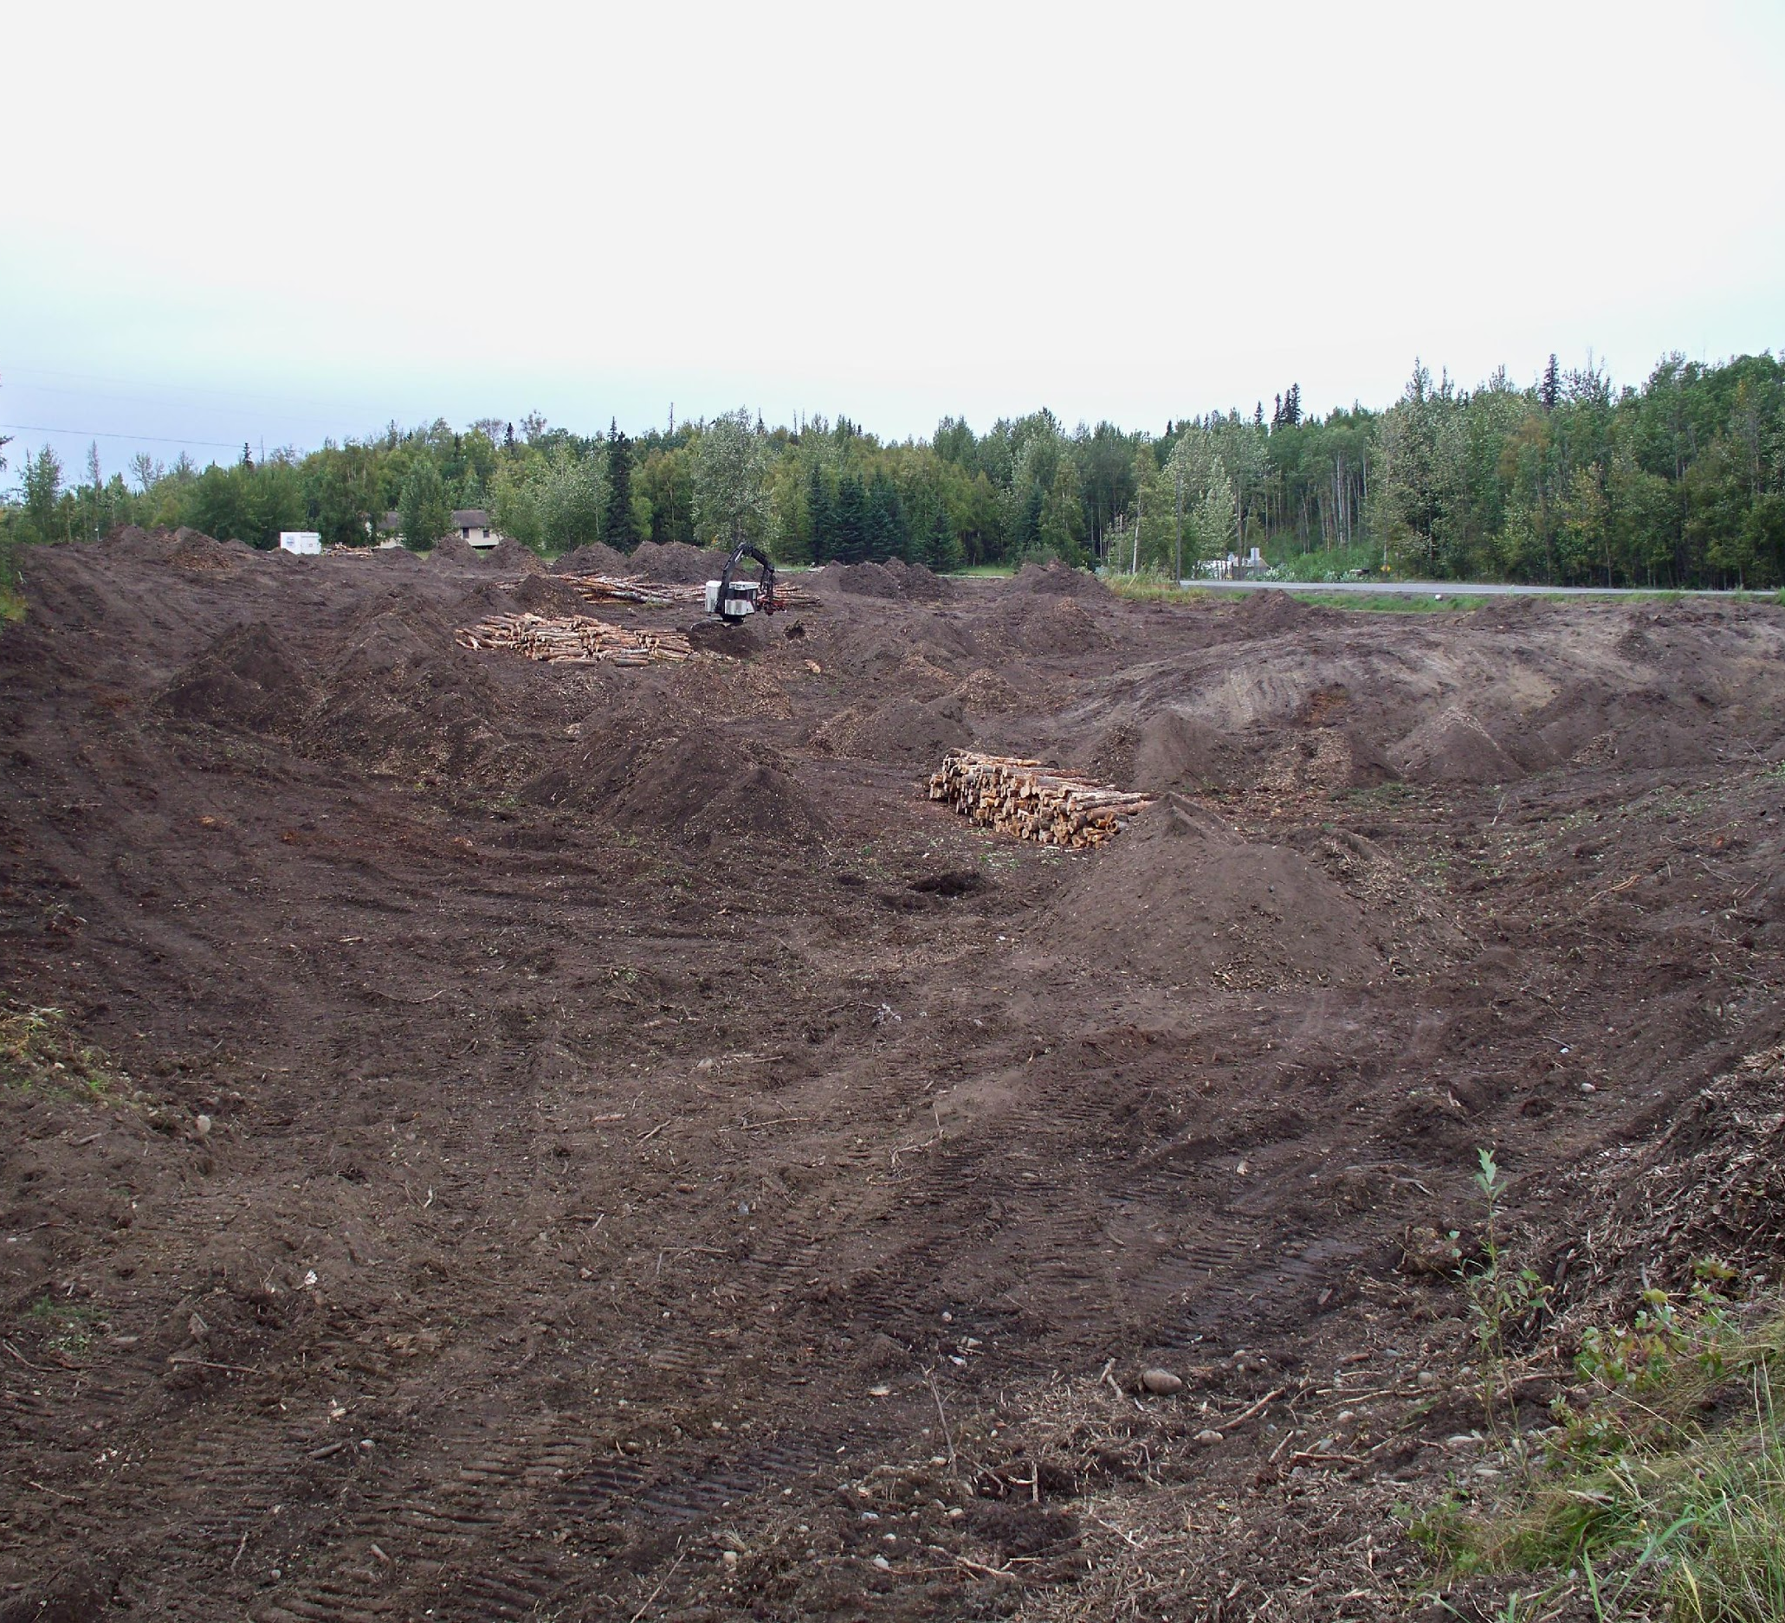
Erosion and Sediment Control Lessons Learned: Sediment Production

Slide 22
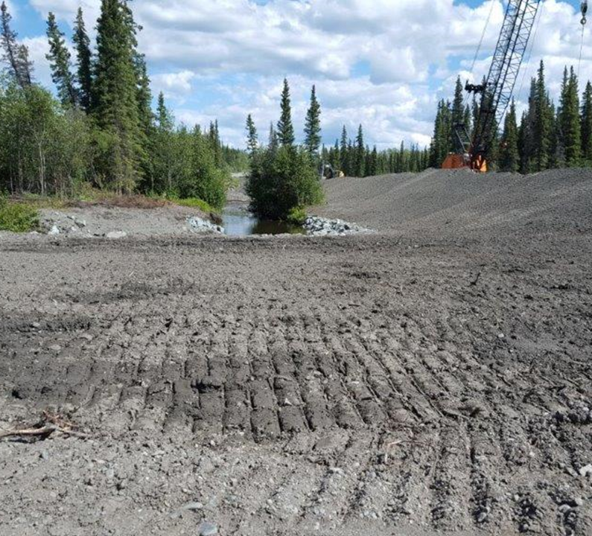
Erosion and Sediment Control: Lessons Learned: Erosion Control
EROSION CONTROLS
Project is phased.
Surface Roughening of all site soils!
Slopes are mulched and seeded.
SEDIMENT CONTROLS
Vegetation buffer at margin of site.
Fiber roll between disturbance and rip rap.
PERMANENT STABILIZATION
Rip Rap around water course.
Vegetation.

Slide 23
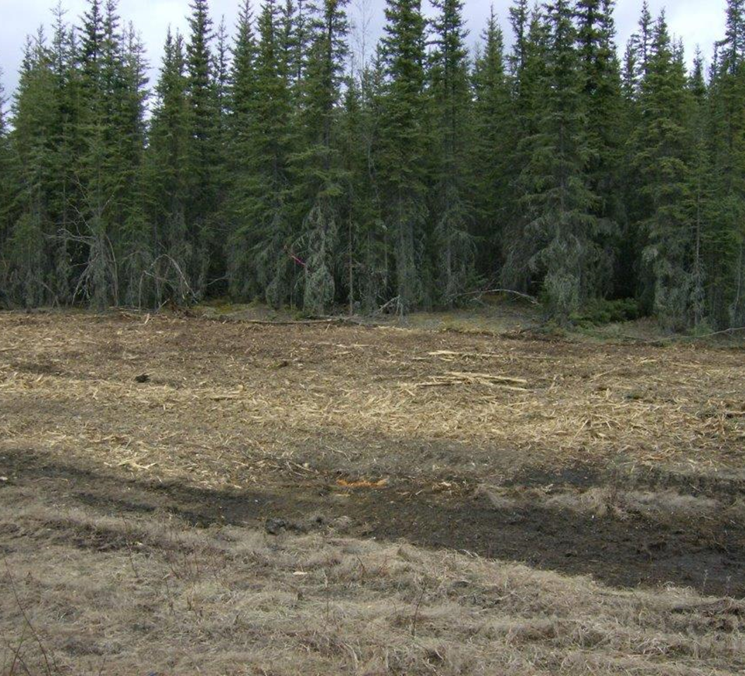
Erosion and Sediment Control Lessons Learned: Construction
Brush Mulch as Erosion Control

Slide 24
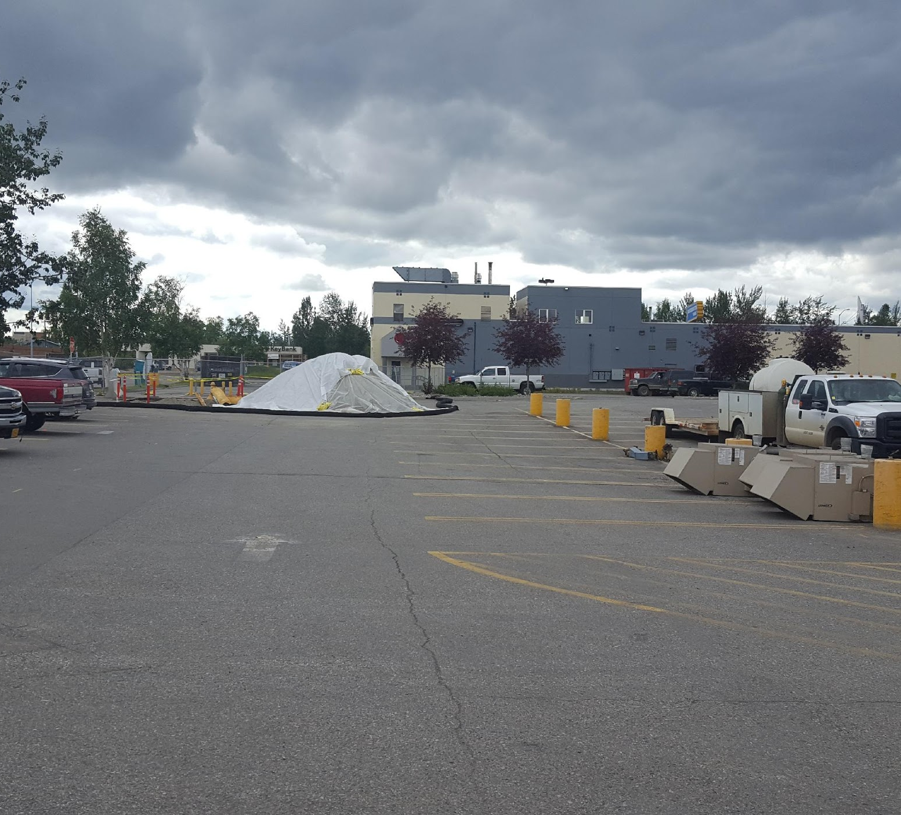
Erosion and Sediment Control Lessons Learned: Construction
EROSION CONTROLS
Plastic Cover
SEDIMENT CONTROL
Wood Chip Fiber Roll
PERMANENT STABILIZATION
Asphalt

Slide 25
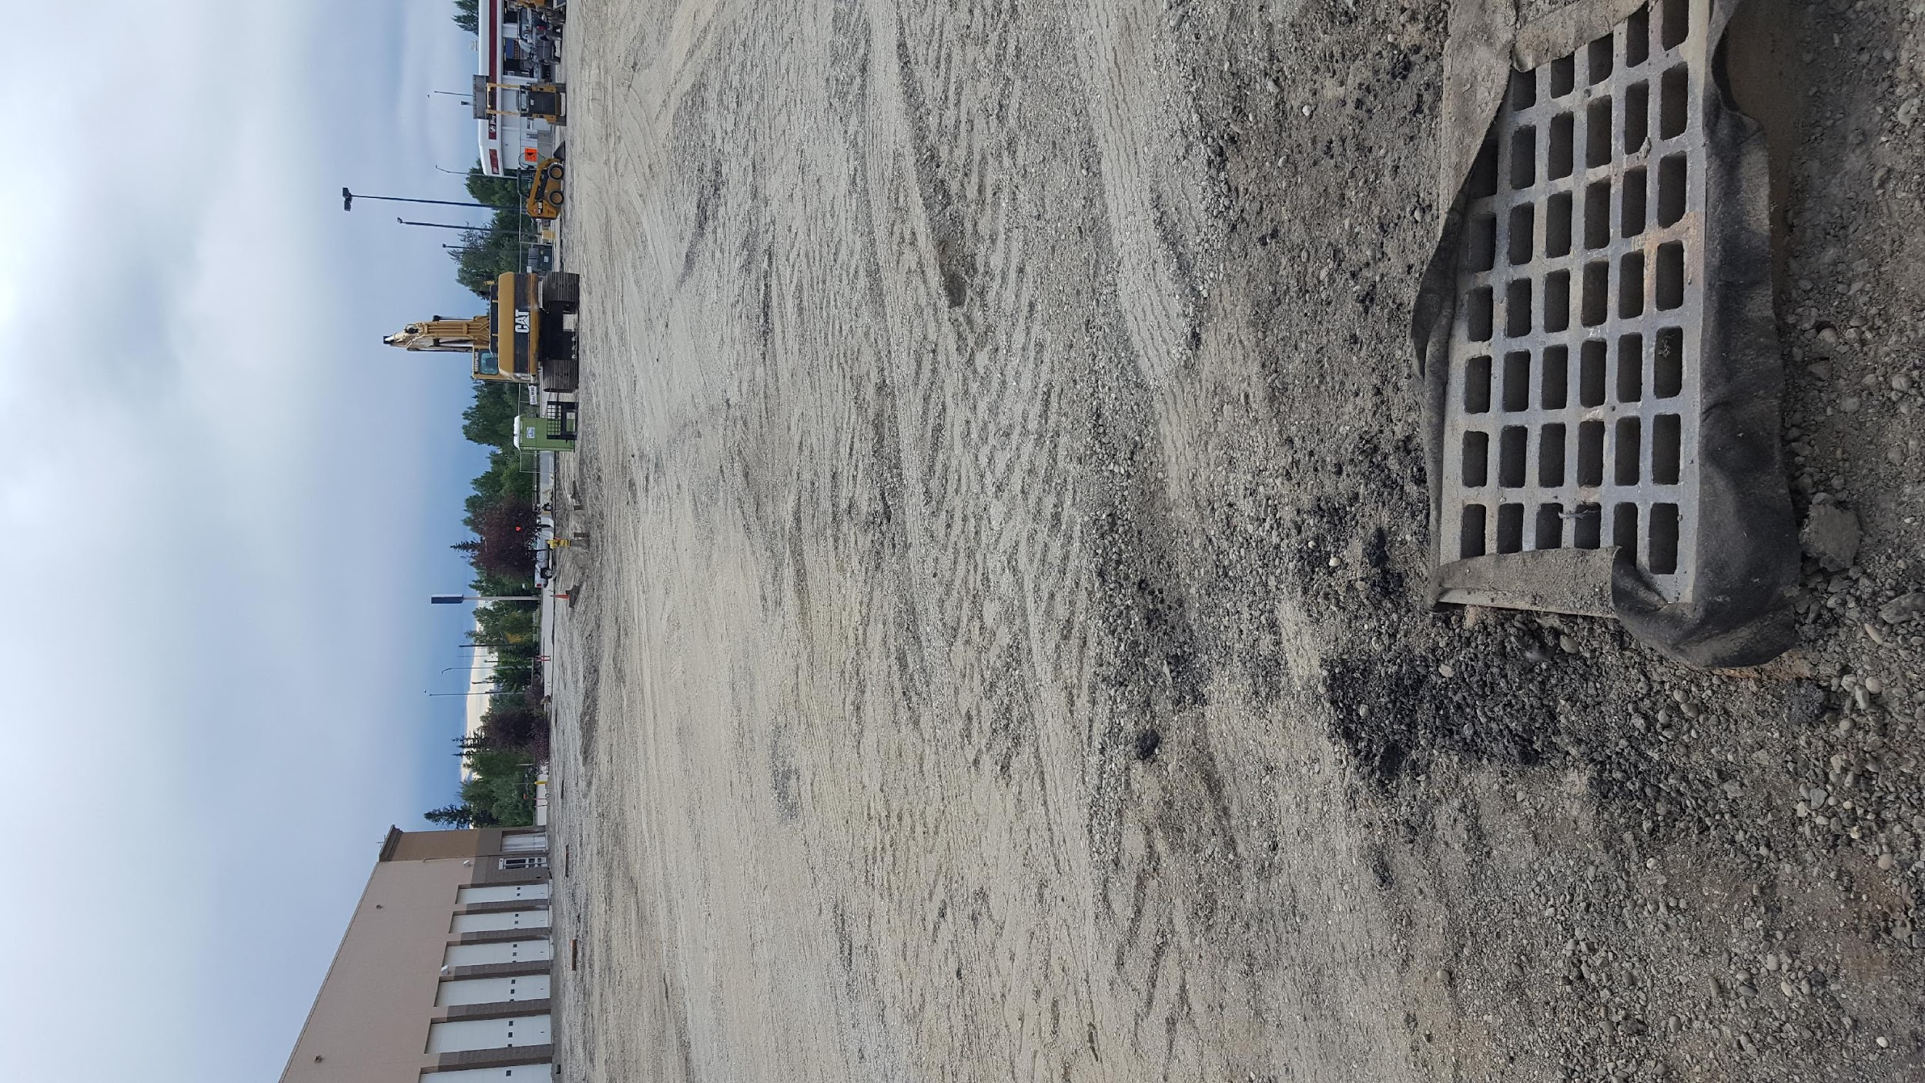
Erosion and Sediment Control Lessons Learned: Cut Back Curb

Slide 26
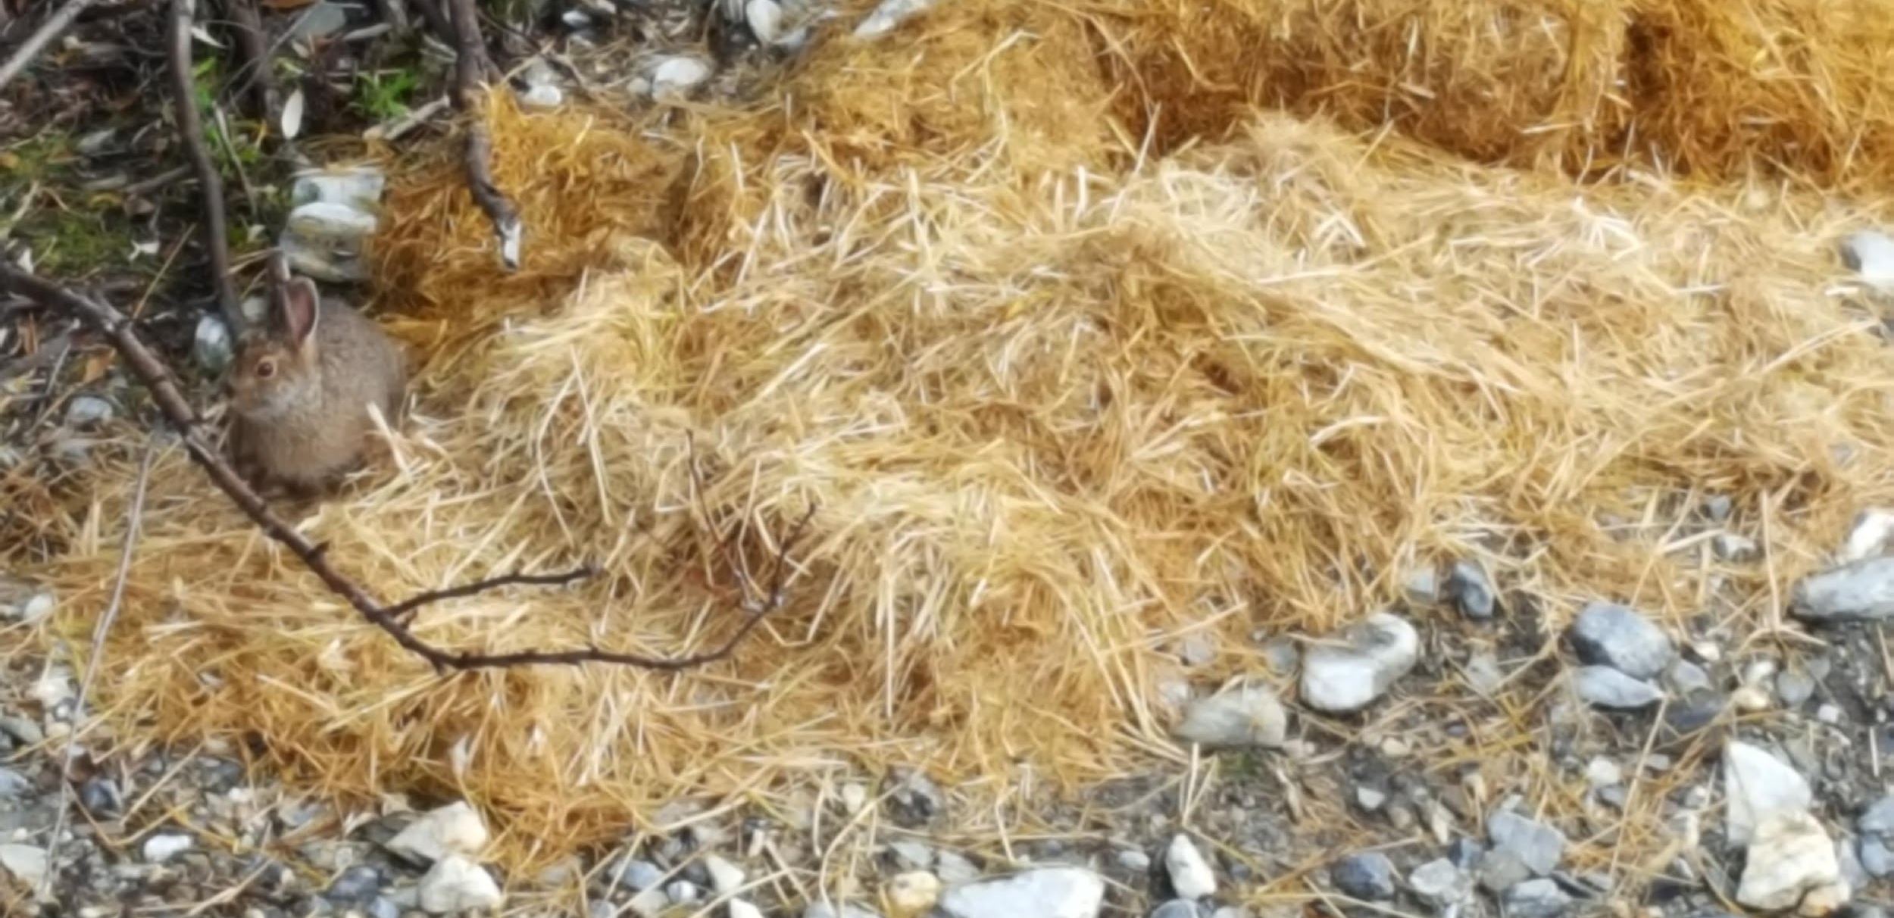
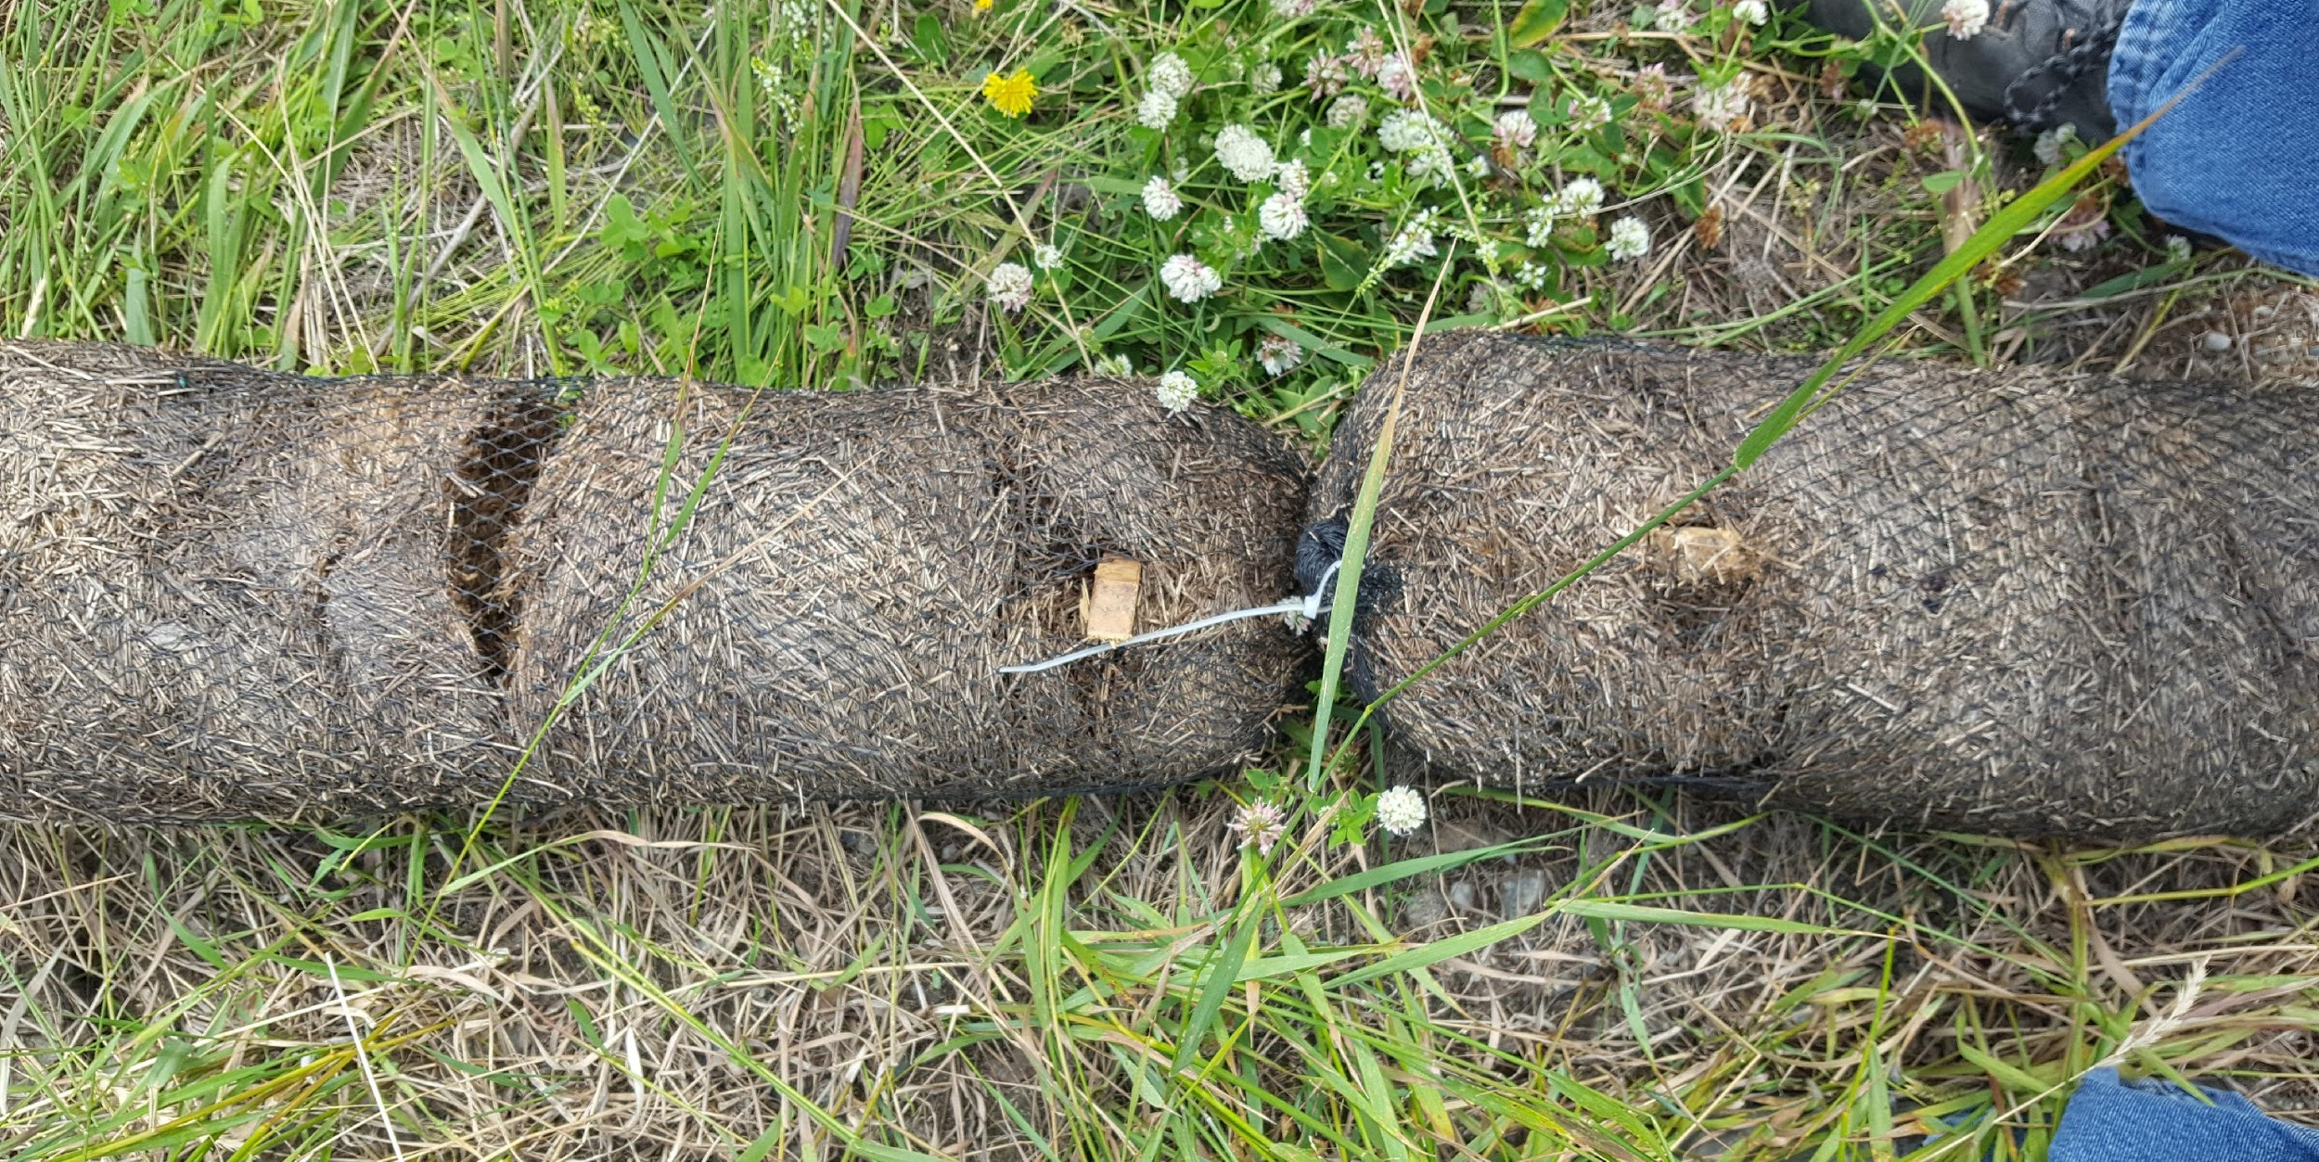
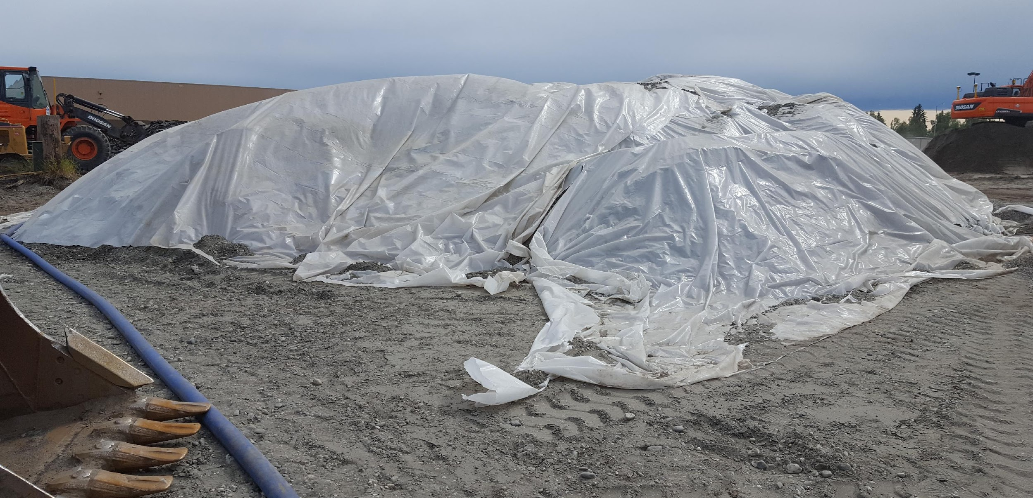
Erosion and Sediment Control Lessons Learned: Maintenance

Slide 27
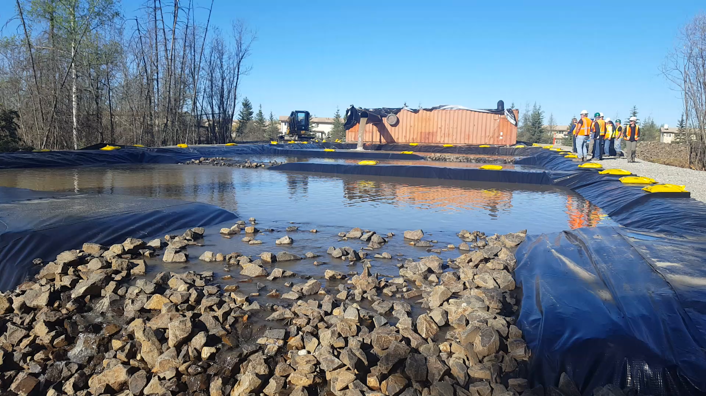
Erosion and Sediment Control Lessons Learned: Dewatering

